Slide 1

Module 1: Working with Requests in Siebel Answers
0/5
Analytics: Advanced Application Developer

Slide 2
Module Objectives
After completing this module you will be able to:
  Combine request criteria using set operations
  Execute direct database requests
  Edit logical SQL generated by a request
  Work with requests in Microsoft (MS) Excel
Why you need to know:
  An understanding of these topics will improve your ability to design and build Siebel Analytics requests

Slide 3
Overview of Siebel Answers
Siebel Analytics user interface used to query an organization’s data
Provides a set of graphical tools to create and execute requests for information
  Request results can be saved, organized, shared, and integrated with other content

Slide 4
Key Terms
Term | Definition
Request | Siebel Answers query against an organization's data
Column | Object that indicates the data that a request will return
Filter | Mechanism that restricts the result set returned by a request
Prompt | Special kind of filter that restricts result set returned by a request
Criteria | Set of columns and filters specified for a request
Results | Output returned from Siebel Analytics Server for specified request
Subject Area | Logical object that organizes and presents data about a business
Dashboard | Page in an Analytics application that displays content
Dashboard Prompt | Filter object that filters all content on a dashboard page
Query | Underlying SQL issued to Siebel Analytics Server for specified request
Web Catalog | Stores content created with Siebel Answers and Intelligence Dashboards

Slide 5

Review: Starting Siebel Answers
To access Siebel Answers in the platform version of Siebel Analytics, select Start > Programs > Siebel Analytics > Siebel Analytics Web
My Dashboard screen appears after entering login credentials
Click the Answers link to navigate to Siebel Answers

Slide 6
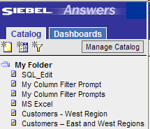
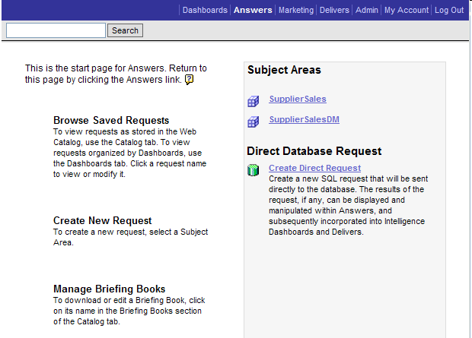
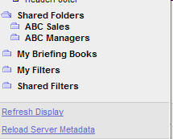
Review: Siebel Answers Start Page
Displays after clicking Answers link
Use selection pane to access saved requests and dashboards
Search for saved requests
Links provide access to Siebel Analytics functions
Select a subject area to create a new request
Workspace provides list of actions and available subject areas
Create a direct database request

Slide 7
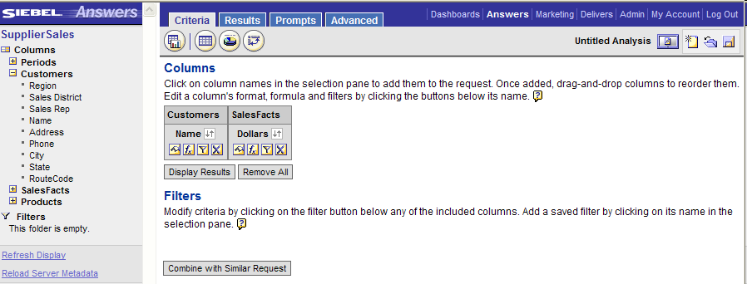
Review: Siebel Answers Workspace
Provides area to create, modify, and save requests and filters
Selection pane shows columns and filters to construct requests
Workspace displays selected content and tabs for working with requests
Content is organized into presentation folders, tables, and columns
Refresh changes made to saved content or metadata

Slide 8

Review: Siebel Answers Tabs
Contain on-screen information and buttons to create, access, and manage requests
View or change columns and filters for requests
View or modify results of requests
Create prompts to filter requests
Work directly with XML and SQL generated for a request
Display compound layout
Display table view
Display chart view
Display pivot table view

Slide 9
Working with Requests in Siebel Answers
0/4
Combining Request Criteria Using Set Operations
Executing Direct Database Requests
Editing Logical SQL Generated by a Request
Working with Requests in MS Excel

Slide 10
Combining Request Criteria Using Set Operations
1/4
Combine criteria from one or more subject areas
  Subject areas may be organized with similar information depending on business needs
Combine results from two or more requests into a single request
  Example: Combine results from subject area containing all active customers with results from subject area containing customers who have ordered one or more products

Slide 11
Set Operators
1/4
Set operators and their effects on results
Set Operator | Effect on Results
Union | Returns non-duplicate rows from all requests
Union All | Returns all rows from all requests
Intersect | Returns rows that are common to all requests
Minus | Returns row from first request that are not in other requests
Union
Union All
Request 1
Request 2
Request 1
Request 2
Row AAA
Row BBB
Row AAA
Row BBB
Row BBB
Row CCC
Row BBB
Row CCC
Intersect
Minus
Request 1
Request 2
Request 1
Request 2
Row AAA
Row BBB
Row AAA
Row BBB
Row BBB
Row CCC
Row BBB
Row CCC

Slide 12
Combining Results of Multiple Requests
1/4
Build a Request
Combine with Similar Request
Construct the Combined Request
Apply Set Operator
Check Results

Slide 13


1. Build a Request
1/4
Build a request with desired columns and filters
Request will return customers with dollars between 5000 and 15000

Slide 14
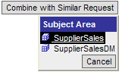
2. Combine with Similar Request
1/4
Click the Combine with Similar Request button and select a subject area
Select same subject area or a different subject area

Slide 15
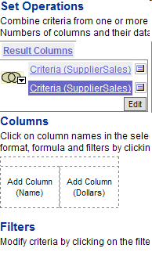
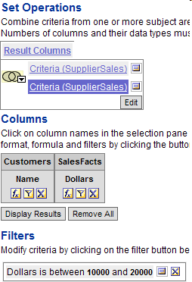
3. Construct the Combined Request
1/4
Add columns and filters to the new request
  Number and data types of the columns selected in each request must be the same
  Column lengths can be different
Click Edit to add additional criteria
Number of columns and data types must be consistent across all criteria
New request will return customers with dollars between 10000 and 20000

Slide 16
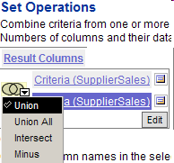
4. Apply Set Operator
1/4
Click the Set button and select the operation type
Set button
Combined request will return union of customers with dollars between 5000 and 20000

Slide 17
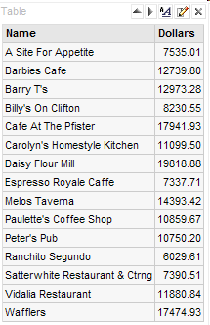
5. Check Results
1/4
Results of two or more requests are combined into a single request
Table displays union of all customers with dollars between 5000 and 20000

Slide 18
Executing Direct Database Requests
2/4
Users with appropriate privileges can create and issue direct database requests to physical back-end data sources
Users should know advanced SQL and understand the content and structure of underlying data sources
Results can be displayed and manipulated within Siebel Answers and incorporated into dashboards

Slide 19
Direct Database Request Privileges
2/4
Edit Direct Database Requests
  Privilege to create direct database requests
  By default, set only for users defined as Siebel Analytics Web administrators
Execute Direct Database Requests
  Privilege to issue physical requests
  By default, not enabled for anyone; can be changed by a Siebel Analytics Web administrator

Slide 20
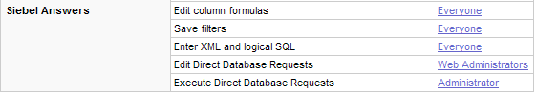
Changing Direct Database Request Permissions
2/4
Changes are made in Siebel Analytics Web Administration
Click Admin link to open Siebel Analytics Web Administration window
Click Manage Privileges link to open Privilege Administration window
Change permissions in Siebel Answers section

Slide 21
Creating and Executing a Direct Database Request
2/4
Create Direct Request
Construct Direct Database Request
Check Results

Slide 22
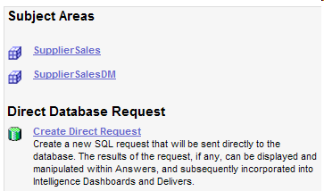
1. Create Direct Request
2/4
Click Create Direct Request on the Siebel Answers start page
Click Create Direct Request link to open the Direct Database Request page

Slide 23
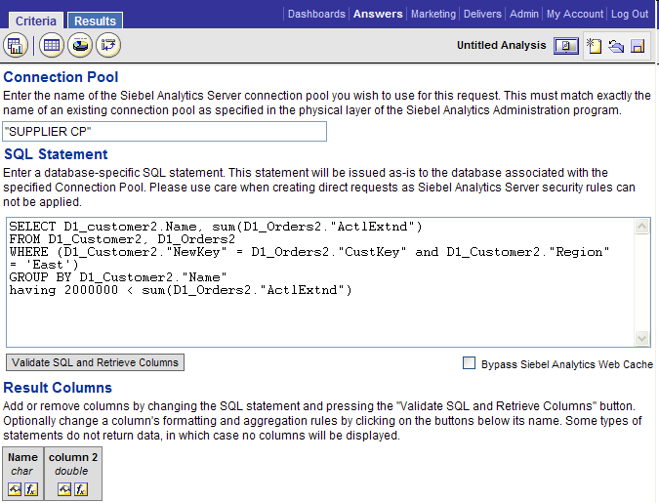
2. Construct Direct Database Request
2/4
Follow on-screen instructions to create the request
Specify connection pool for database defined in the physical layer of the repository
Click Results to issue request
Use quotes if there are spaces
Enter a database-specific SQL statement
CAUTION: Siebel Analytics security rules are bypassed
Bypass Siebel Analytics Web cache if desired
Validate SQL and retrieve columns
Change column formatting if desired

Slide 24
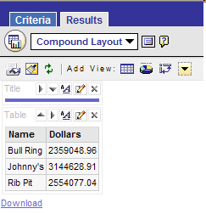
3. Check Results
2/4
Results are displayed in the Siebel Answers workspace
Manipulate results as you would for any request

Slide 25
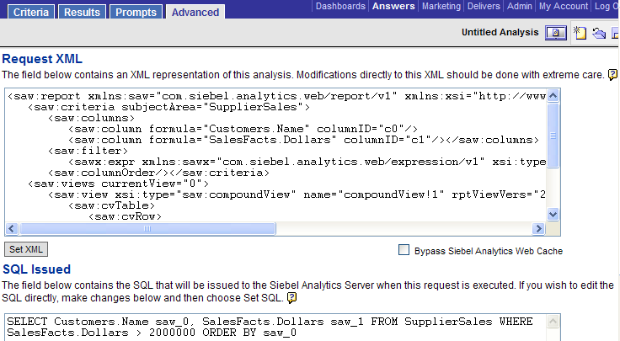

Editing Logical SQL Generated by a Request
3/4
For advanced users and developers with
  Permission to access Advanced tab
  Knowledge of advanced SQL
  Expertise working with Siebel Analytics Server metadata
  Understanding of content and structure of underlying data sources
Create or modify request and click Advanced tab
Changing XML changes request in Web Catalog
Modify request XML and click Set XML
Changing SQL changes query sent to Analytics Server
Modify request SQL and click Set SQL

Slide 26
Working with Requests in Microsoft Excel
4/4
Requires Siebel Analytics MS Excel add-in
  Adds a Siebel Analytics toolbar to MS Excel application
  Provides ability to open saved requests and work with the results from within MS Excel
  Provides two format options
    Unformatted data: Shows underlying request data only without report formatting applied in Siebel Answers
    Formatted data: Shows MS Excel version of compound layout view
      Includes items compatible with MS Excel: column formatting, grand totals, and views included in compound layout view
Siebel Analytics toolbar added to MS Excel

Slide 27
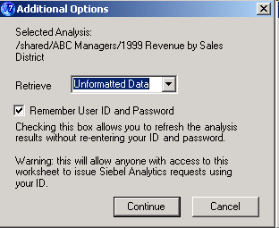
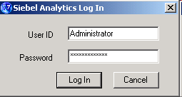
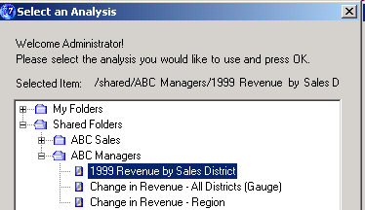
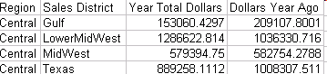
Opening a Saved Request from Within MS Excel
4/4
1. Click Select Analysis
4. Select data format
2. Provide login credentials
3. Select a saved request
5. Work with data in MS Excel
6. Refresh Siebel Analytics data

Slide 28
Summary
This module showed you how to:
  Combine request criteria using set operations
  Execute direct database requests
  Edit logical SQL generated by a request
  Work with requests in Microsoft (MS) Excel

Slide 29
Lab
In the lab you will:
  Work with requests in Siebel Answers

